Slide 1

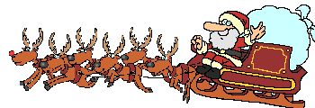
Christmas traditions
in Great Britain

Slide 2
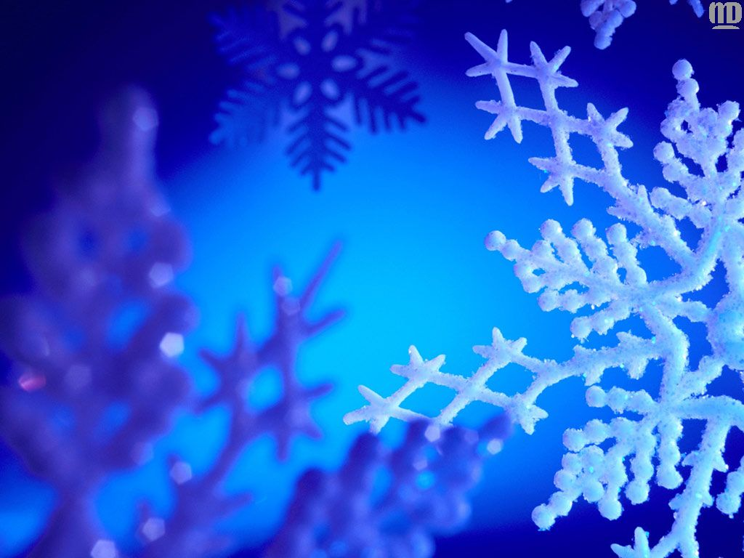
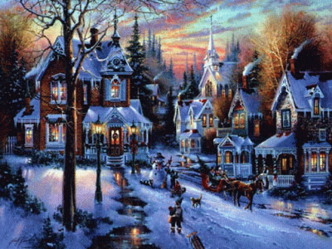
Christmas Day
The 25th of December is Christmas Day. It's a happy holiday for many people in different countries. It is time to give and receive presents.

Slide 3
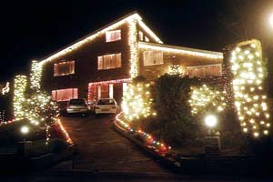
English people decorate their houses and flats with multicoloured lights

Slide 4
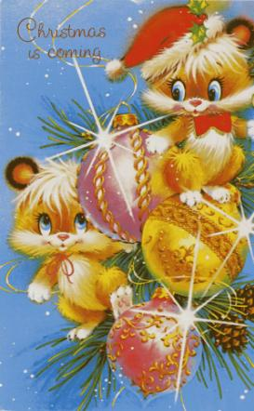
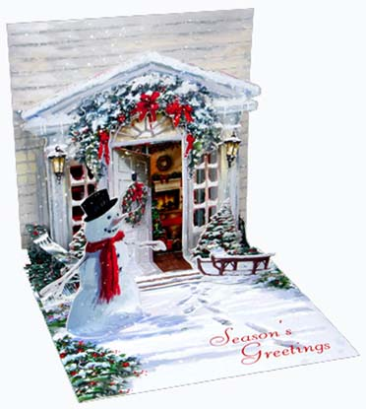
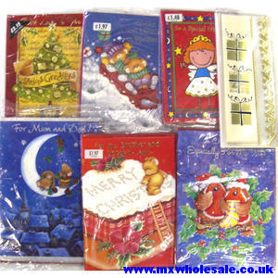
Christmas Cards
Some weeks before Christmas English people are busy. They send greeting cards to all their relatives and friends. You can buy Christmas cards or you can make them. Many children make their cards at school.

Slide 5
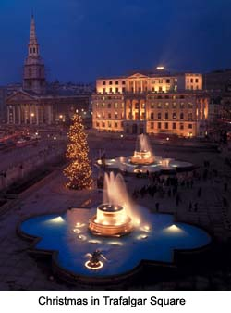
Christmas in Trafalgar Square
Every year there is a very big Christmas Tree in the centre of London in Trafalgar Square. This is a present from the people of Norway to the people of Great Britain.

Slide 6
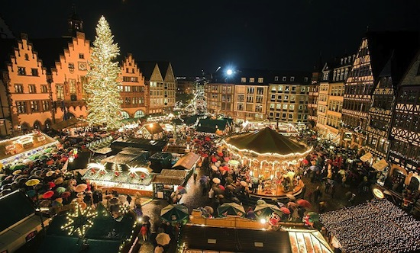
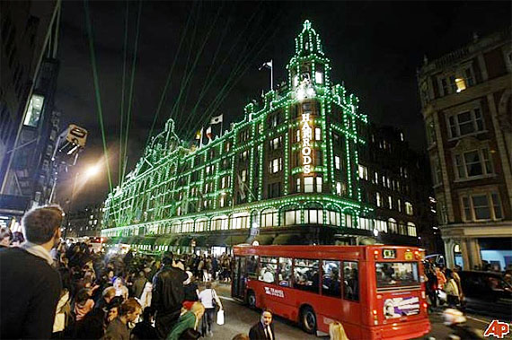
Shopping on Christmas
The shops are very busy on Christmas. People buy presents for their family and friends.
They buy a lot of food and drinks for all the Christmas parties.

Slide 7
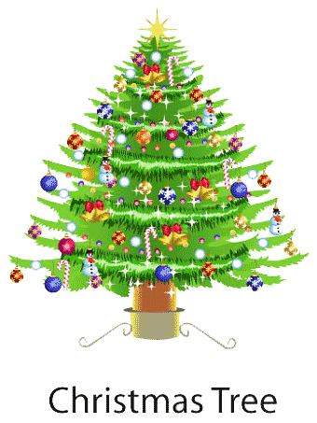
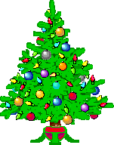

Christmas Tree at home
People buy a Christmas Tree and decorate it with toys, coloured balls and little coloured lights.
On Christmas Eve people put their presents under the tree.

Slide 8
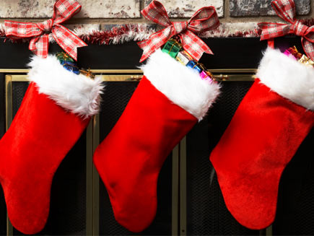
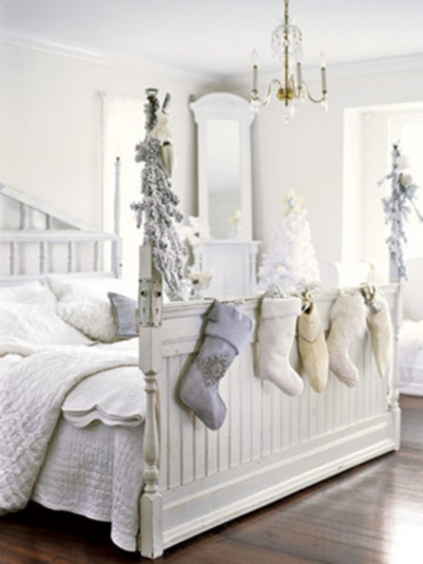
Stockings
Children like and wait for Christmas most of all. When they go to bed they hang the stockings for the presents on the fire-place or near their beds.

Slide 9
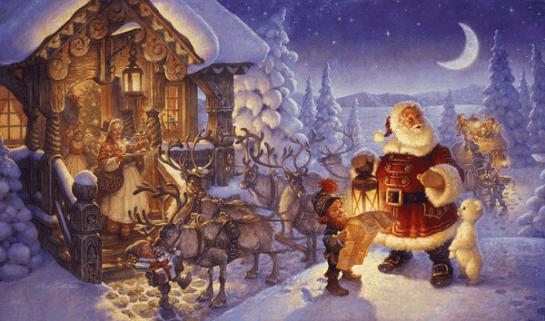
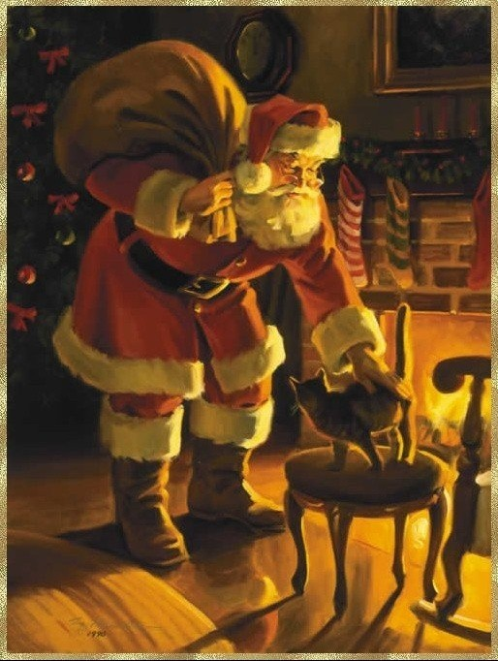
Santa comes…
At night Santa Claus comes, usually through the chimney. He has got a big bag of presents for children.

Slide 10
People open their presents on Christmas morning and they all are happy with what they get.

Slide 11
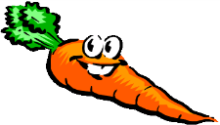
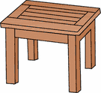
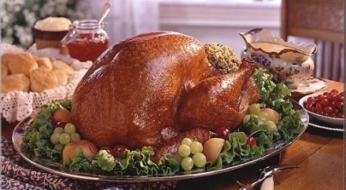
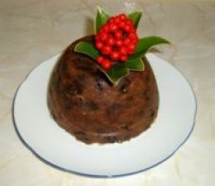
Christmas food
For Christmas dinner people eat turkey, potatoes and greeneries. Then they have the Christmas pudding. At 5 o`clock it`s time for tea and Christmas cake.

Slide 12
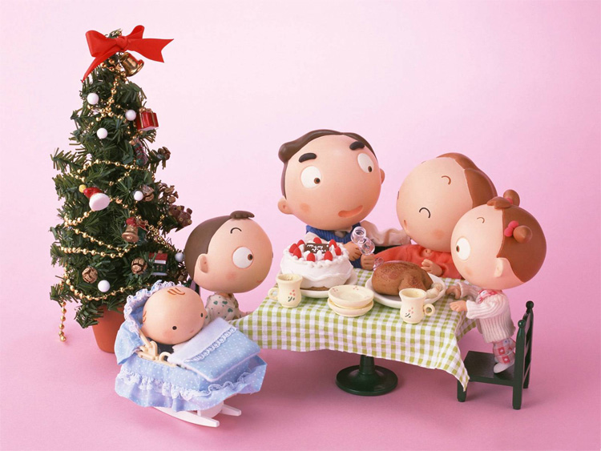
Christmas parties
On Christmas families come together and wish each other a merry Christmas.

Slide 13
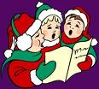
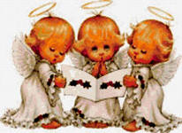
Carols
Christmas carols are special songs which are sung during а Christmas season.
The songs are about Jesus and
the time when he was born.

Slide 14
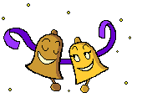

Jingle bells
Dashing through the snow,
In a one-horse open sleigh,
O'er the fields we go,
Laughing all the way.
Bells on bobtail ring,
Making spirits bright.
What fun it is to ride and sing,
A sleighing song tonight.
Oh, jingle bells, jingle bells,
Jingle all the way,
Oh, what fun it is to ride
In a one-horse open sleigh.
Jingle bells, jingle bells,
Jingle all the way,
Oh, what fun it is to ride
In a one-horse open sleigh.

